Slide 1
Maven North Wind challenge practice Final
File created on: 24-12-2023 12:28:20

Slide 2
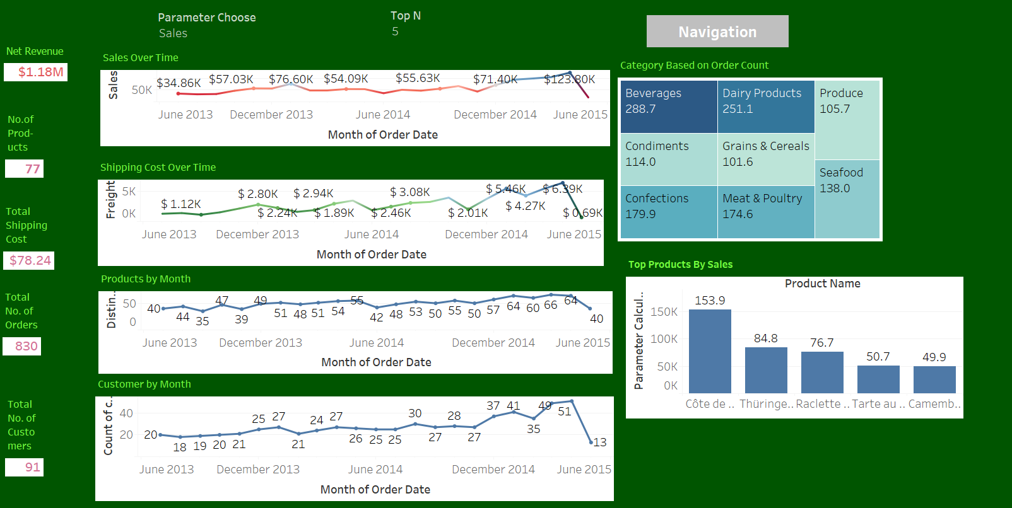

Slide 3
